Slide 1
Maryland’s Workforce System
and the
Workforce Innovation and Opportunity Act
James E. Rzepkowski, Assistant Secretary
Division of Workforce Development and Adult Learning
Maryland Department of Labor

Slide 2
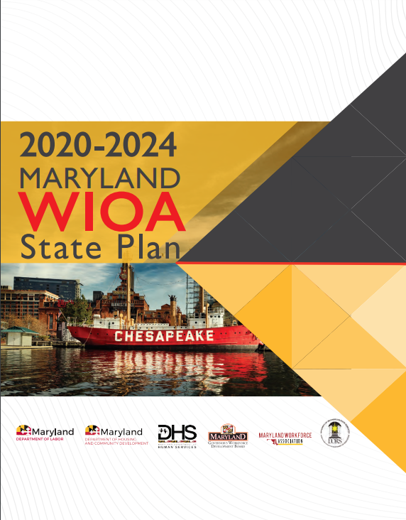
State Plan
Recent Accomplishments
September 2022 - Federal partners approved MD’s update to the 2020-2024 State Workforce Plan
October 2022 - Maryland released State Workforce Plan to public
November 2022 - Maryland released formal guidance for Regional and Local Plans

Slide 3
WIOA State Plan Program | Core WIOA Program as determined by law | Additional WIOA Program as determined by Governor | MD state Agency Responsible for Oversight
Adult Program |  |  | MD Labor
Dislocated Workforce Program |  |  | MD Labor
Youth Program |  |  | MD Labor
Wagner-Peyser Act Program |  |  | MD Labor
Adult Education and Family Literacy Act Program |  |  | MD Labor
Vocational Rehabilitation Program |  |  | MSDE
Temporary Assistance for Needy Families Program |  |  | DHS
*NEW IN 2023* Supplemental Nutrition Assistance Program Employment & Training |  |  | DHS
Trade Adjustment Assistance for Workers Program |  |  | MD Labor
Jobs for Veterans State Grant Program |  |  | MD Labor
Unemployment Insurance |  |  | MD Labor
Senior Community Service Employment Program |  |  | MD Labor and Senior Service America, Inc.
Reentry Employment Opportunities |  |  | Local partners
Community Service Block Grant |  |  | DHCD

Slide 4
State Plan Overview
One Shared Vision | Five Strategic Goals
Increase the earning capacity of Marylanders by maximizing access to employment, skills and credentialing, life management skills, and supportive services.
Maximize access to employment;
Maximize access to/use of skills and credentialing;
Maximize access to/use of life management skills;
Eliminate barriers to employment; and
Strengthen and enhance the effectiveness and efficiency of Maryland’s workforce system.

Slide 5
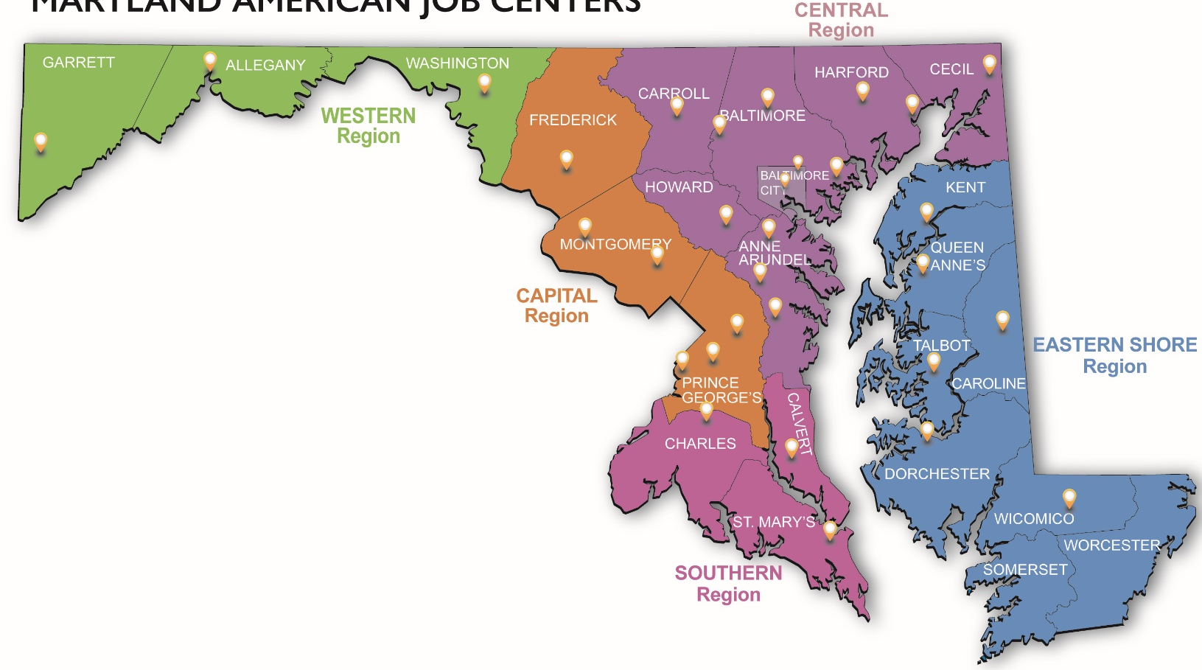
Today’s Business
Feb. 1, 2023 - Regional Plans due
March 1, 2023 - Regional plans reviewed by GWDB and State and recommendations issued
May 1, 2023 - Local Plans due
Summer 2023 - Local Plans under review by GWDB and State – approve at September 6, 2023 GWDB Quarterly meeting

Slide 6
Regional Plan Staff Recommendations
Central Maryland Regional Plan
(Anne Arundel, Baltimore City, Baltimore County, Carroll County, Howard County, Susquehanna)
Recommendation: Conditionally approved with minor revisions. Finals are due within 30 days.
Shore Regional Plan
(Caroline, Dorchester, Kent, Queen Anne’s Somerset, Talbot, Wicomico, Worcester Counties)
Recommendation: Conditionally approved with minor revisions. Finals are due within 30 days.

Slide 7
Questions?
James E. Rzepkowski, Assistant Secretary
Division of Workforce Development and Adult Learning
Maryland Department of Labor
james.rzepkowski@maryland.gov
(O) 410-767-2924

